Slide 1

Employee Data Analysis using Excel
STUDENT NAME: F.Reshma fathima
REGISTER NO:12237 ( asunm1323132200055)
DEPARTMENT:B.COM (cooperation)
COLLEGE: The Quaide Milleth College For Men
1
Notes:
1

Slide 2

PROJECT TITLE
Employee Satisfaction Analysis Using Excel Charts
2

Slide 3



AGENDA
Problem Statement
Project Overview
End Users
Our Solution and Proposition
Dataset Description
Modelling Approach
Results and Discussion
Conclusion
3/21/2024 Annual Review
3

Slide 4

PROBLEM STATEMENT
Improve employee satisfaction scores within the next .
Increase employee engagement and productivity.
Enhance our organization’s reputation as a great place to work.
4

Slide 5

PROJECT OVERVIEW
.
This project is about to find out about working satisfaction level of the employees for the better running of the company and also to find way to boost their morale if the face any dissatisfaction. This project is also conducted to check how to enhance the organization reputation as a great place to work.
5

Slide 6

WHO ARE THE END USERS?
Owner
Shareholders
Employees
Customers
6

Slide 7

OUR SOLUTION AND ITS VALUE PROPOSITION
Our solution:
Filtering : filtering out the data which is needed.
Pivot table : pivot table is used to understand the summary of the analysis.
Graph : graph is used for the visualization of the analysis.
7

Slide 8
Dataset Description
Employees Dataset is downloaded from the kaggle website.
There were 10 features.
Only 4 features were taken for the analysis.
Employee number in numerical order.
Environment Satisfaction level.
Job Satisfaction level.
Worker life Balance.

Slide 9

THE "WOW" IN OUR SOLUTION
The wow is the analysis to show the satisfaction level of the employee and the results tell how to increase the employee satisfaction level and develop the profit level of the company.
3/21/2024 Annual Review
9

Slide 10
MODELLING
1.Data collection :
it is downloaded from kaggle
it is also downloaded from edunet dashboard and compared with each other.
After comparison the data sets from kaggle is used.
2.Data cleaning :
After downloading the data sets, the necessary data are filtered out.
3.Summary :
After filtering out the data the pivot table is used for the summarization of the analysis.
4.Visualization:
After entering pivot table, graph is used for the Visualization of the analysis.
10

Slide 11
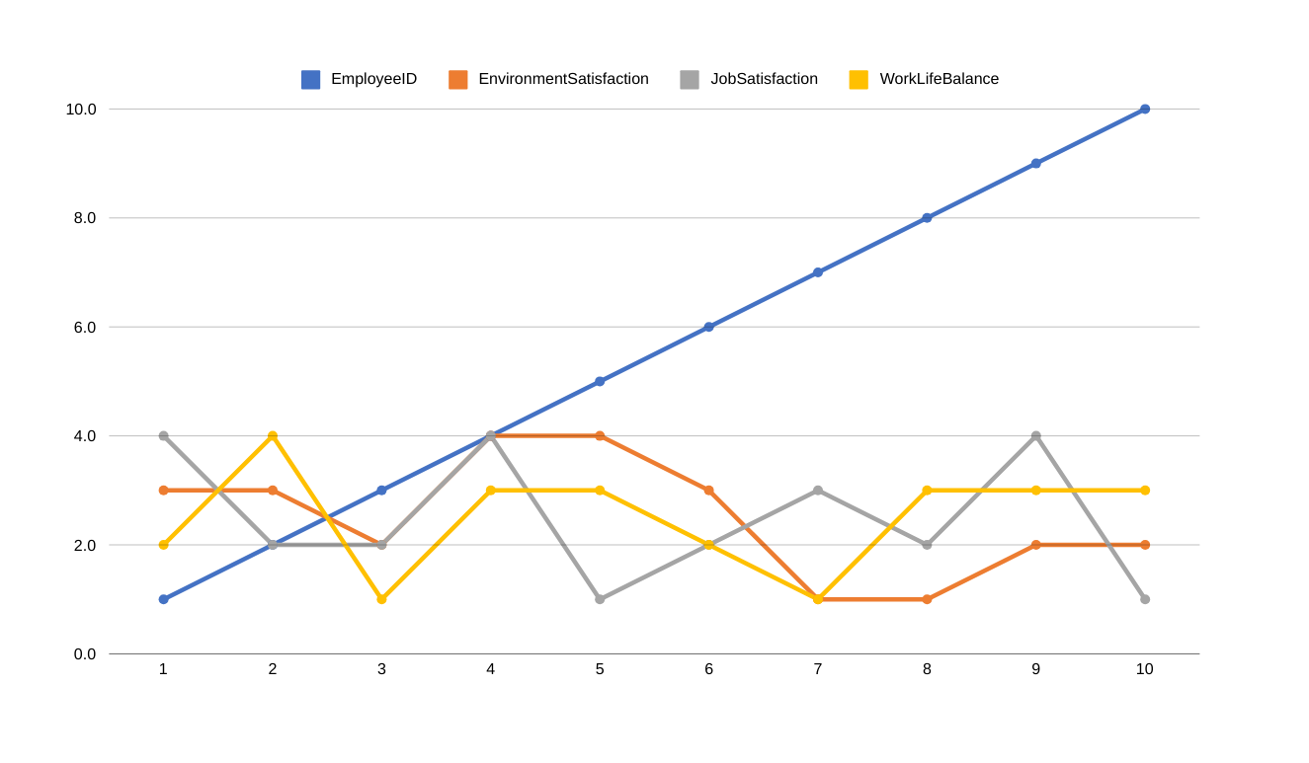
RESULTS
11

Slide 12
conclusion
The given data is the analysis of satisfaction level of the employee for better working and running of the company.

